Slide 1
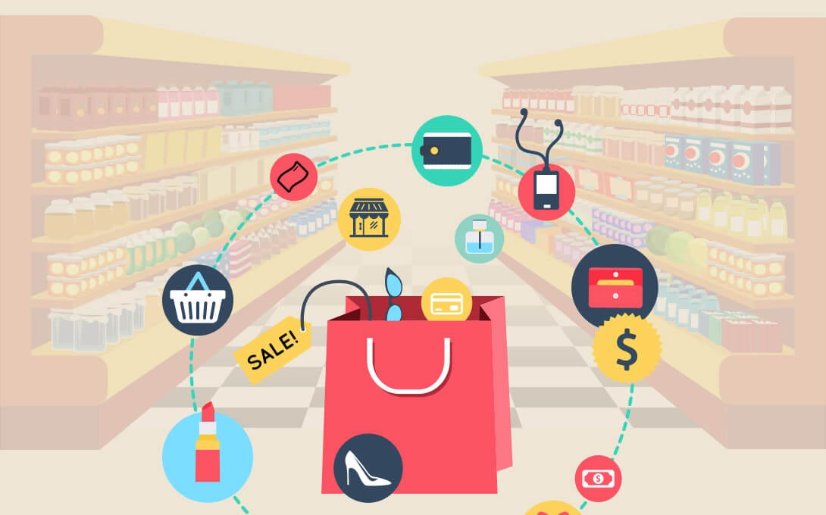
Market Basket Analysis
Sanjana .V. Choudhari 3BR23CD086
Shirisha T.S. 3BR23CD088
Guide: Mr.Bharath

Slide 2
What is Market Basket Analysis?
Market Basket Analysis(MBA) is a data mining technique used by retailers to understand the purchase behavior of customers by discovering associations between different items that customers place in their shopping baskets.
KEY CONCEPTS:
Itemset: A collection of one or more items.
Support: Frequency of an itemset appearing in the dataset.
support(A)=Transactions containing A/Total transactions.
Confidence: Likelihood that item B is bought when item A is bought.
Confidence(A->B)=Support(A U B)/Support(A)
Lift: Measures how much more likely B is bought when A is bought compared to B being bought independently.
Lift(A->B)=Confidence(A->B)/Support(B)

Slide 3
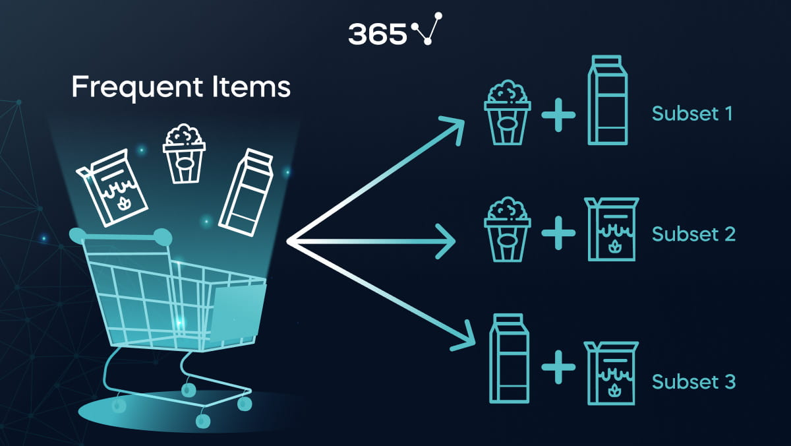
Applications:
Retail: Product placement, promotions, inventory management.
E-commerce: Recommendation systems (“Customers who bought this also bought…”).
Banking: Cross-selling financial products
Popular Algorithms:
Apriori Algorithm – Generates frequent itemsets and rules by using support thresholds.
FP-Growth – Uses a tree structure to find frequent itemsets more efficiently.
Eclat – Uses vertical data format for faster itemset mining.

Slide 4
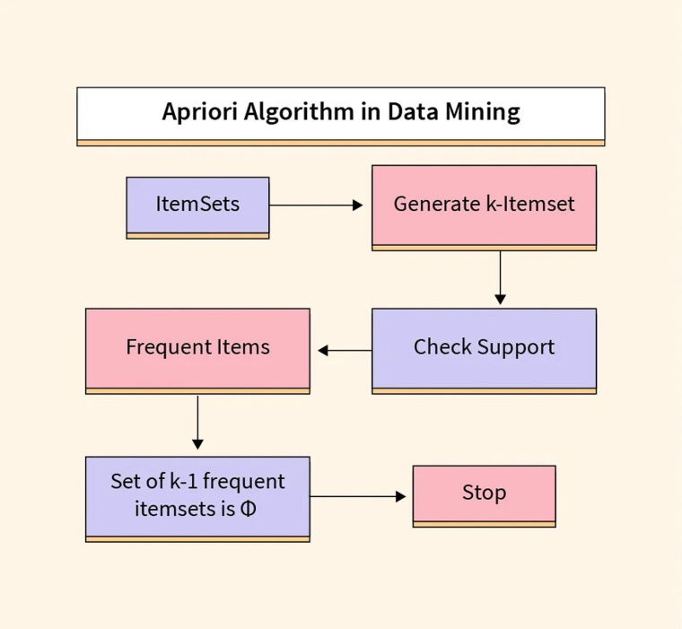
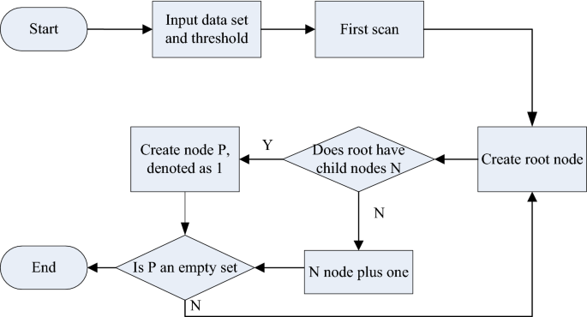
1. Apriori Algorithm
Key Idea:
Uses a bottom-up approach (starts from single items, expands to larger sets).
Generates candidate itemsets, then filters them using support threshold.
Pros:
Simple and easy to implement.
Useful for small to medium datasets.
Cons:
Generates many candidates → slow on large datasets.
Needs multiple database scans.
2. FP-Growth (Frequent Pattern Growth)
Key Idea:
Builds a compact tree structure (FP-tree) instead of generating candidates.
Uses recursive pattern mining from the FP-tree.
Pros:
Faster than Apriori for large datasets.
Needs only two database scans.
Cons:
Tree structure is complex to implement manually.

Slide 5
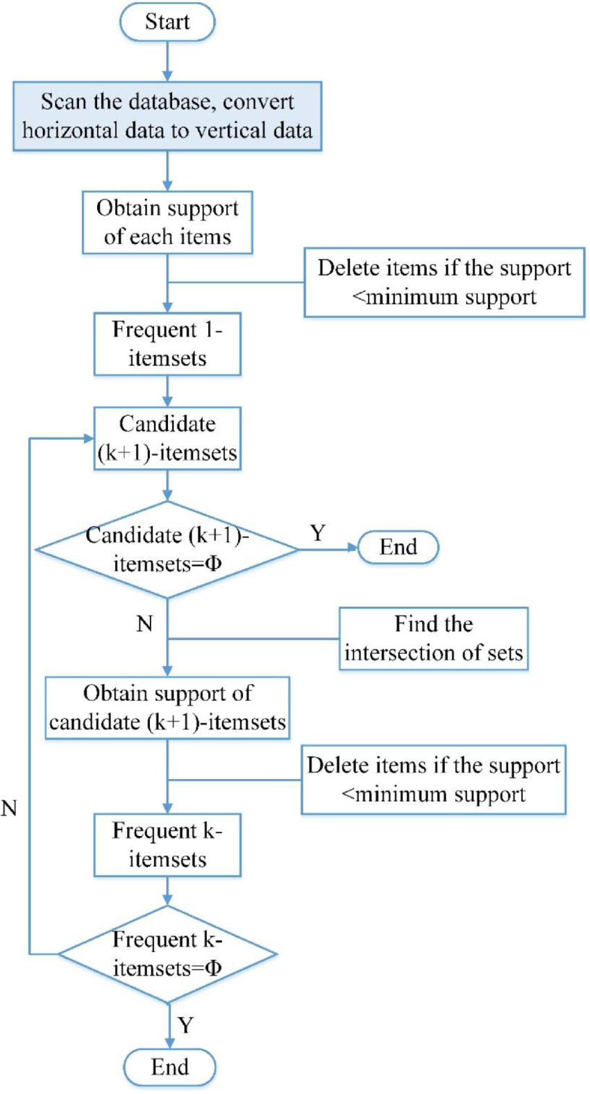
3. ECLAT (Equivalence Class Transformation)
Key Idea:
Uses vertical data format (item → transaction ID list).
Finds frequent itemsets using intersection of transaction IDs.
Pros:
Efficient for datasets with many frequent itemsets.
Performs well when transactions are short but numerous.
Cons:
Uses more memory due to TID-lists.
Less popular, limited library support.

Slide 6
Comparison Table:
Algorithm | Candidate Generation | Data Format | Performance | Best For
Apriori | Yes | Horizontal | Slower on big data | Simple cases, learning
FP-Growth | No | FP-Tree | Fast | Large transactional datasets
ECLAT | No | Vertical (TID-list) | Very fast | Dense datasets

Slide 7
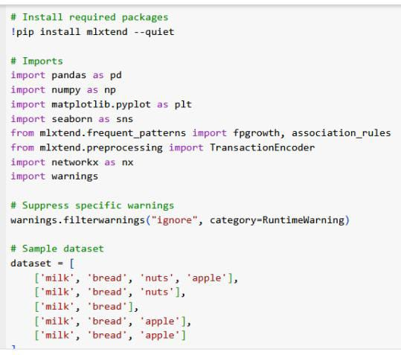
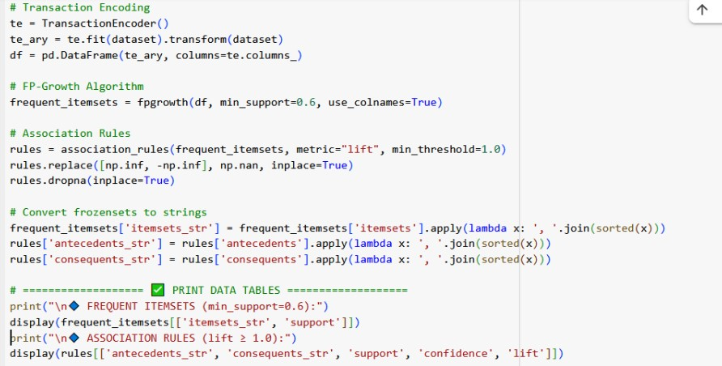
Source Code:

Slide 8
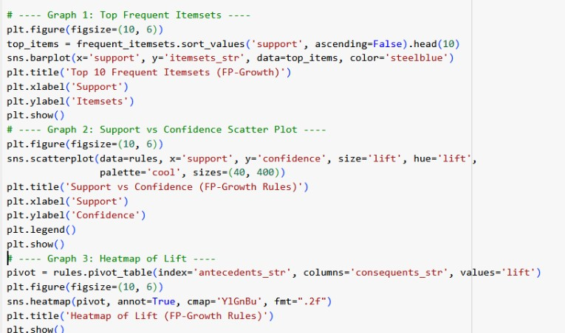
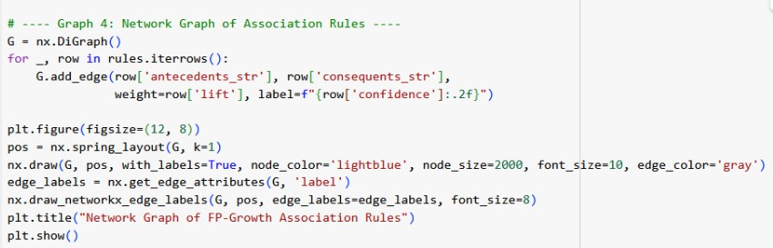

Slide 9
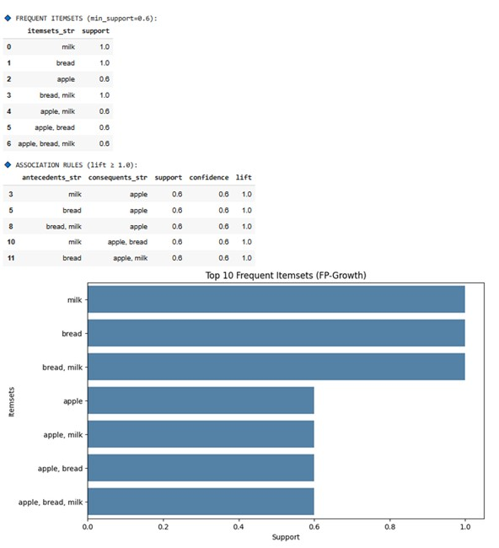
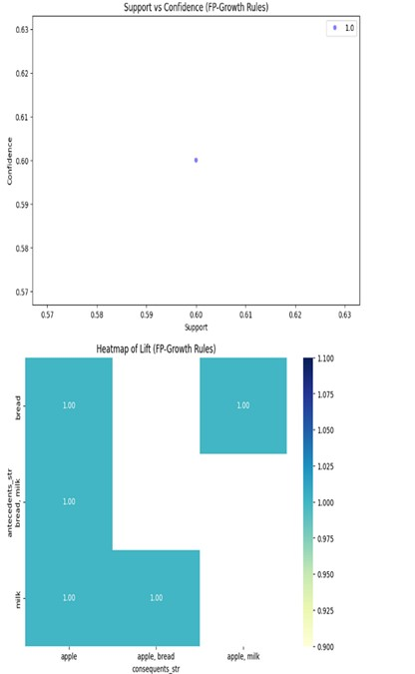
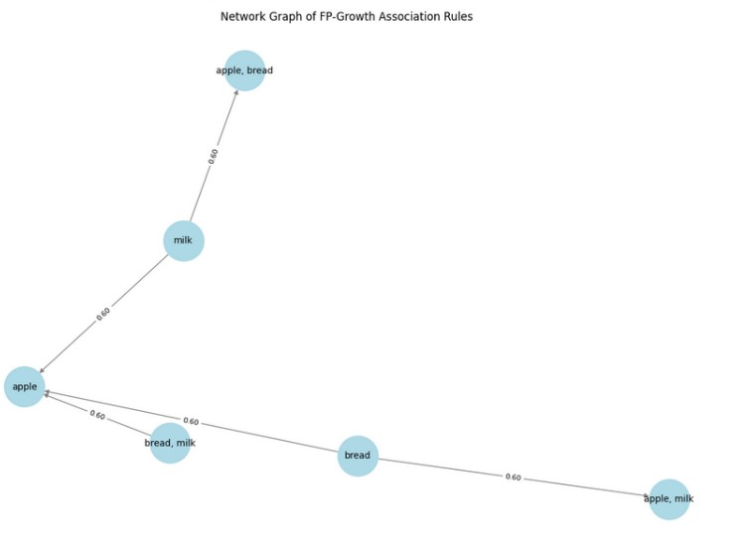

Slide 10
LIBRARIES USED:
pandas, numpy: data manipulation.
matplotlib, seaborn: visualizations.
mlxtend: for fpgrowth and association_rules.
networkx: for graph visualization of rules.
warnings: to suppress unnecessary warnings
DATASET is a list of transactions. Each list inside dataset represents one customer's basket.
TRANSACTION ENCODING:Converts the list of transactions into a binary matrix, where each row is a transaction and each column is an item (True if present, False otherwise).
Frequent Itemset Mining with FP-Growth: fpgrowth finds item combinations (itemsets) that appear together in at least 60% of transactions.
use_colnames=True keeps the item names instead of index numbers.
Association Rule Generation: Generates rules like: If A, then B, with metrics like:
Support: How often itemset appears.
Confidence: Probability of B given A.
Lift: How much more likely B is when A occurs, compared to random chance.
Then it replaces inf/-inf values with NaN and drops them.

Slide 11
String Conversion for Display: Converts frozensets (used to store itemsets) into readable comma-separated strings
for display and plotting.
VISUALISATIONS:
1. Top 10 Frequent Itemsets (Bar Chart): Highlights the most commonly occurring item combinations.
Helps identify which product sets are frequently bought together.
Useful in inventory management and marketing (e.g., bundle offers)
2. Support vs Confidence (Scatter Plot): Shows the relationship between support and confidence for each rule.
Lift is visualized using size and color to show rule strength: High lift = stronger association.
Helps identify rules that are both frequent and reliable
3. Heatmap of Lift: Gives a matrix view of rule strength (lift) between items.
Makes it easy to spot strong associations between specific item pairs.
Helps in visualizing dense regions of strong rules.
4. Network Graph of Association Rules: Represents rules as a directed graph:
Nodes = itemsets Arrows = rules Labels = confidence
Visually shows how items influence one another.
Helps find central or influential items in rule relationships (like "milk").

Slide 12
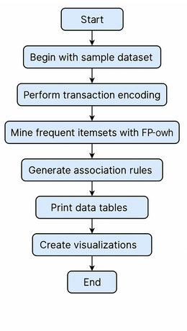
Visualization | Key Insight
Bar Chart | What itemsets are most frequent
Scatter Plot | Which rules are strong and reliable
Heatmap | Which item pairs have the strongest lift
Network Graph | How items are connected through rules
They together help convert raw rule data into actionable insights for things like:
Cross-selling
Shelf organization
Product recommendations

Slide 13


